Slide 1
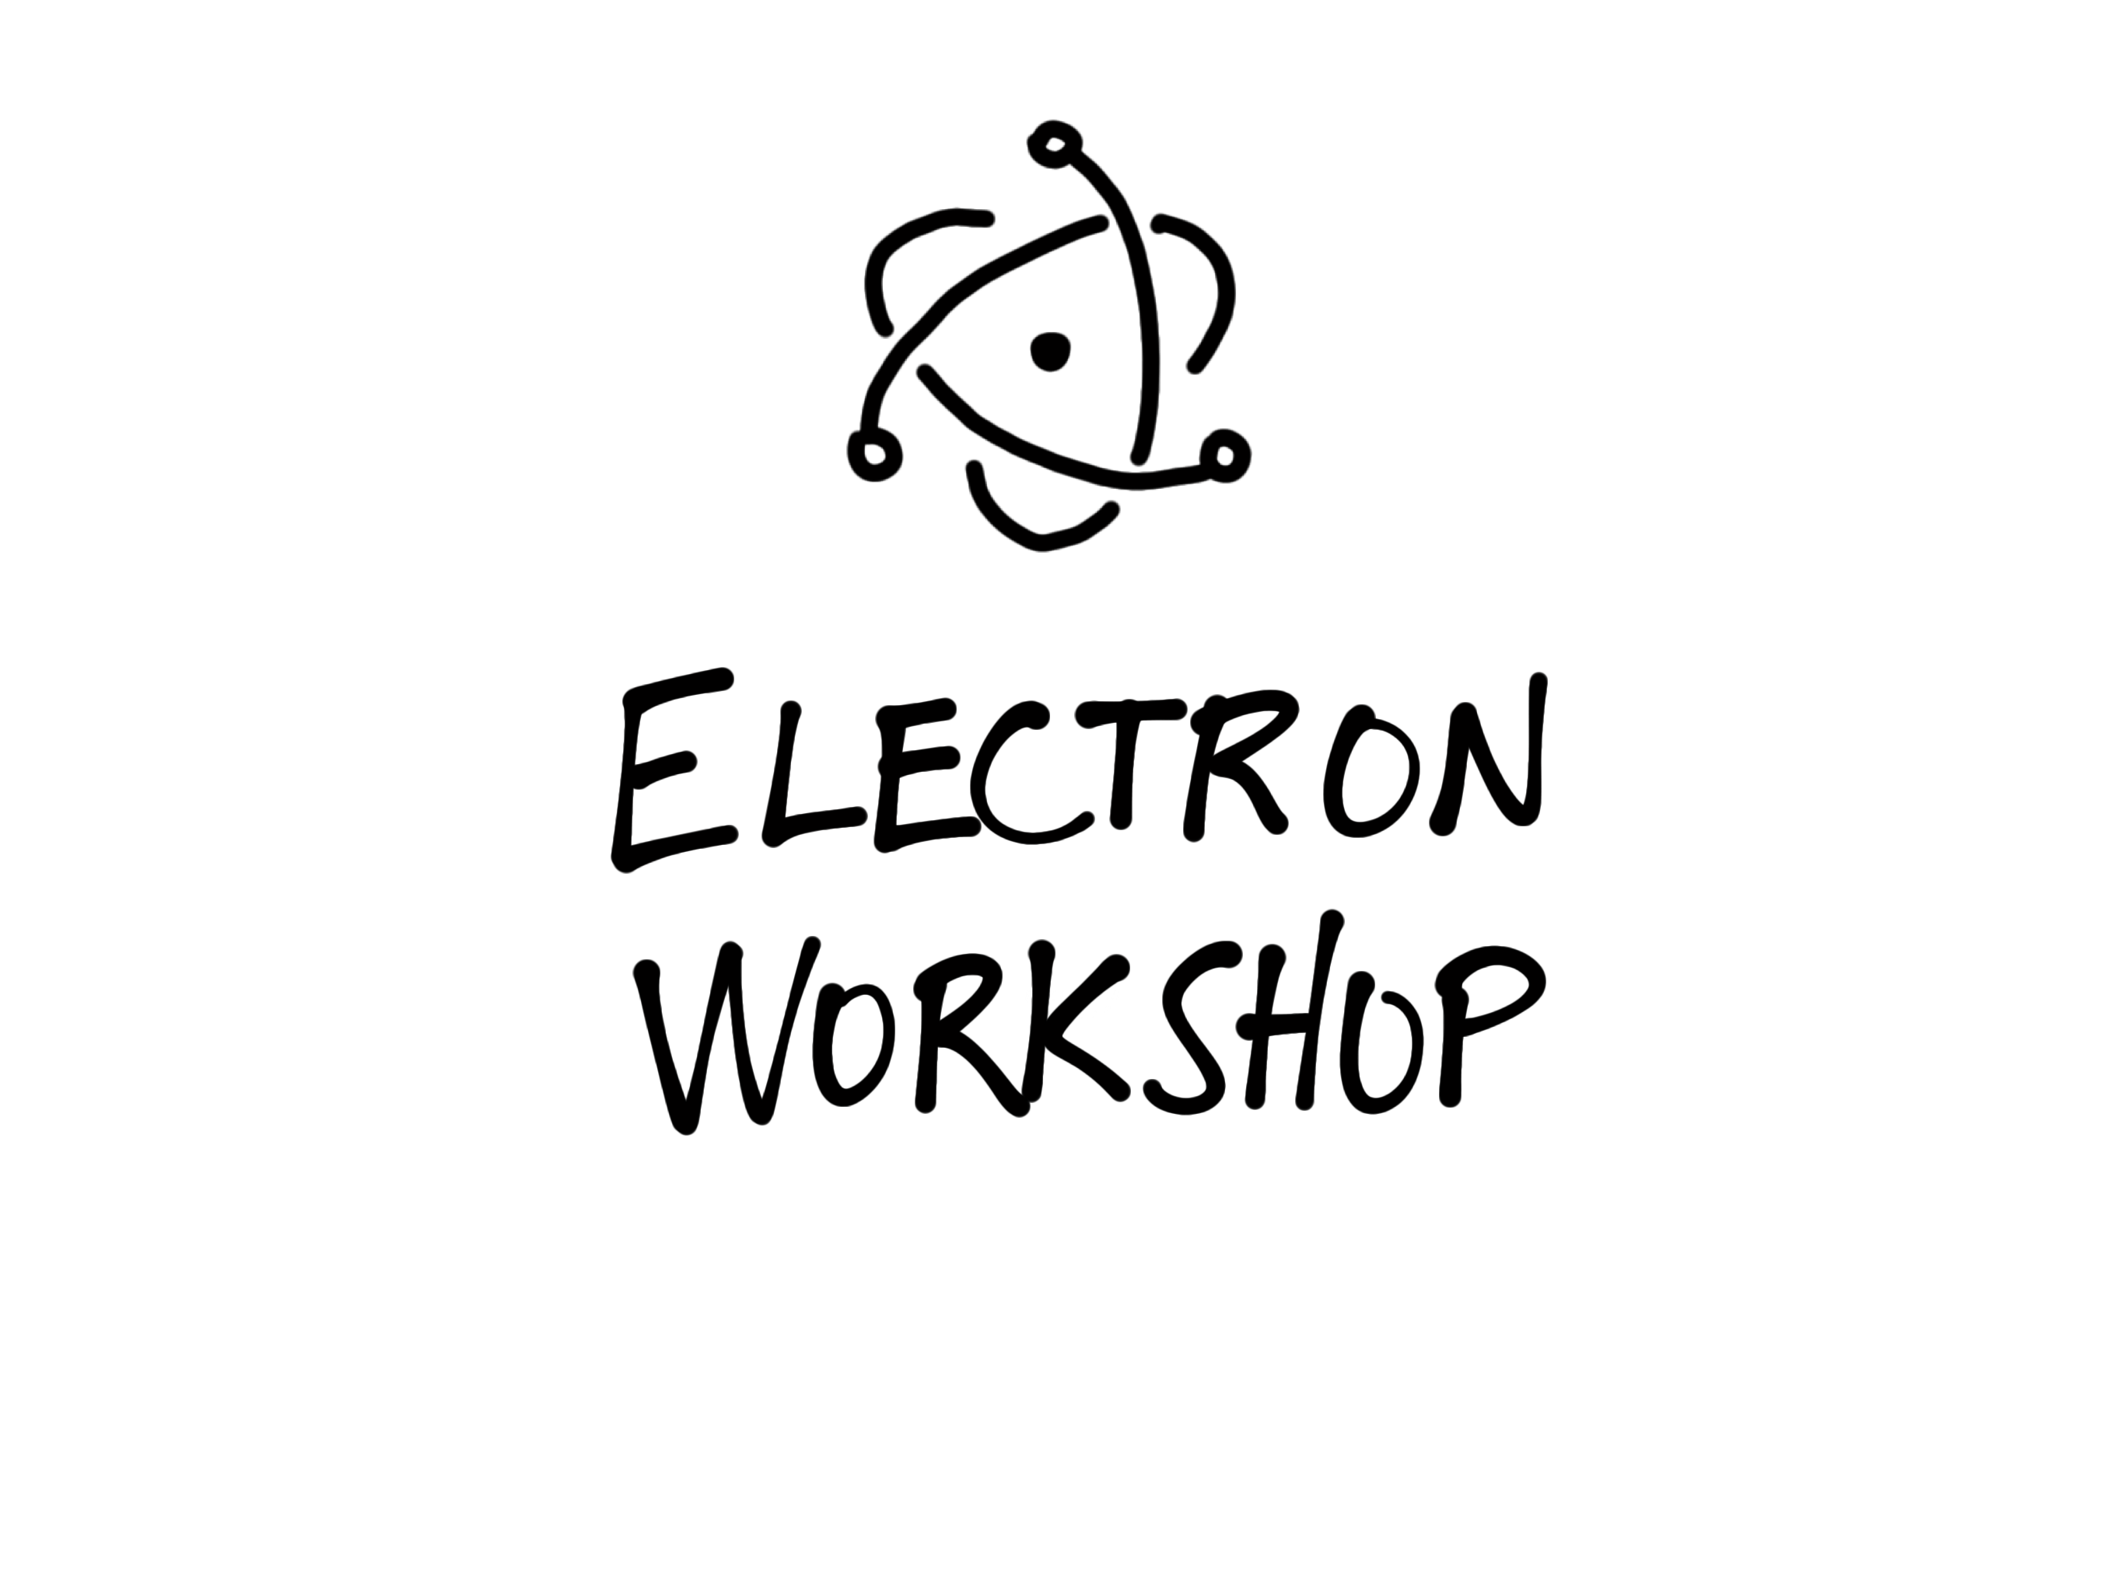



Slide 2

Up Ahead
Intro to Electron
Create an App
Live Reload
Debug
IPC
Package
Tests

Slide 3

Set up and initialize your project
https://bit.ly/electron-workshop
- or –
https://github.com/reverentgeek/electron-workshop/wiki
After completing Exercise 1, Part 1

Slide 4
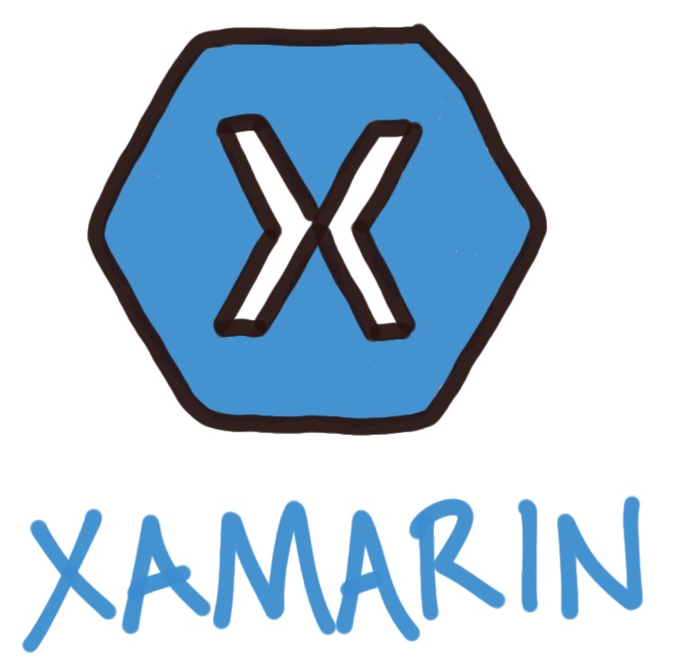
.NET + Mono + Xamarin
Pros:
Shared .NET code base
Cons:
Xamarin Mac !== Xamarin iOS/Android
Native UI is hard
Deployment
Licensing

Slide 5


Slide 6
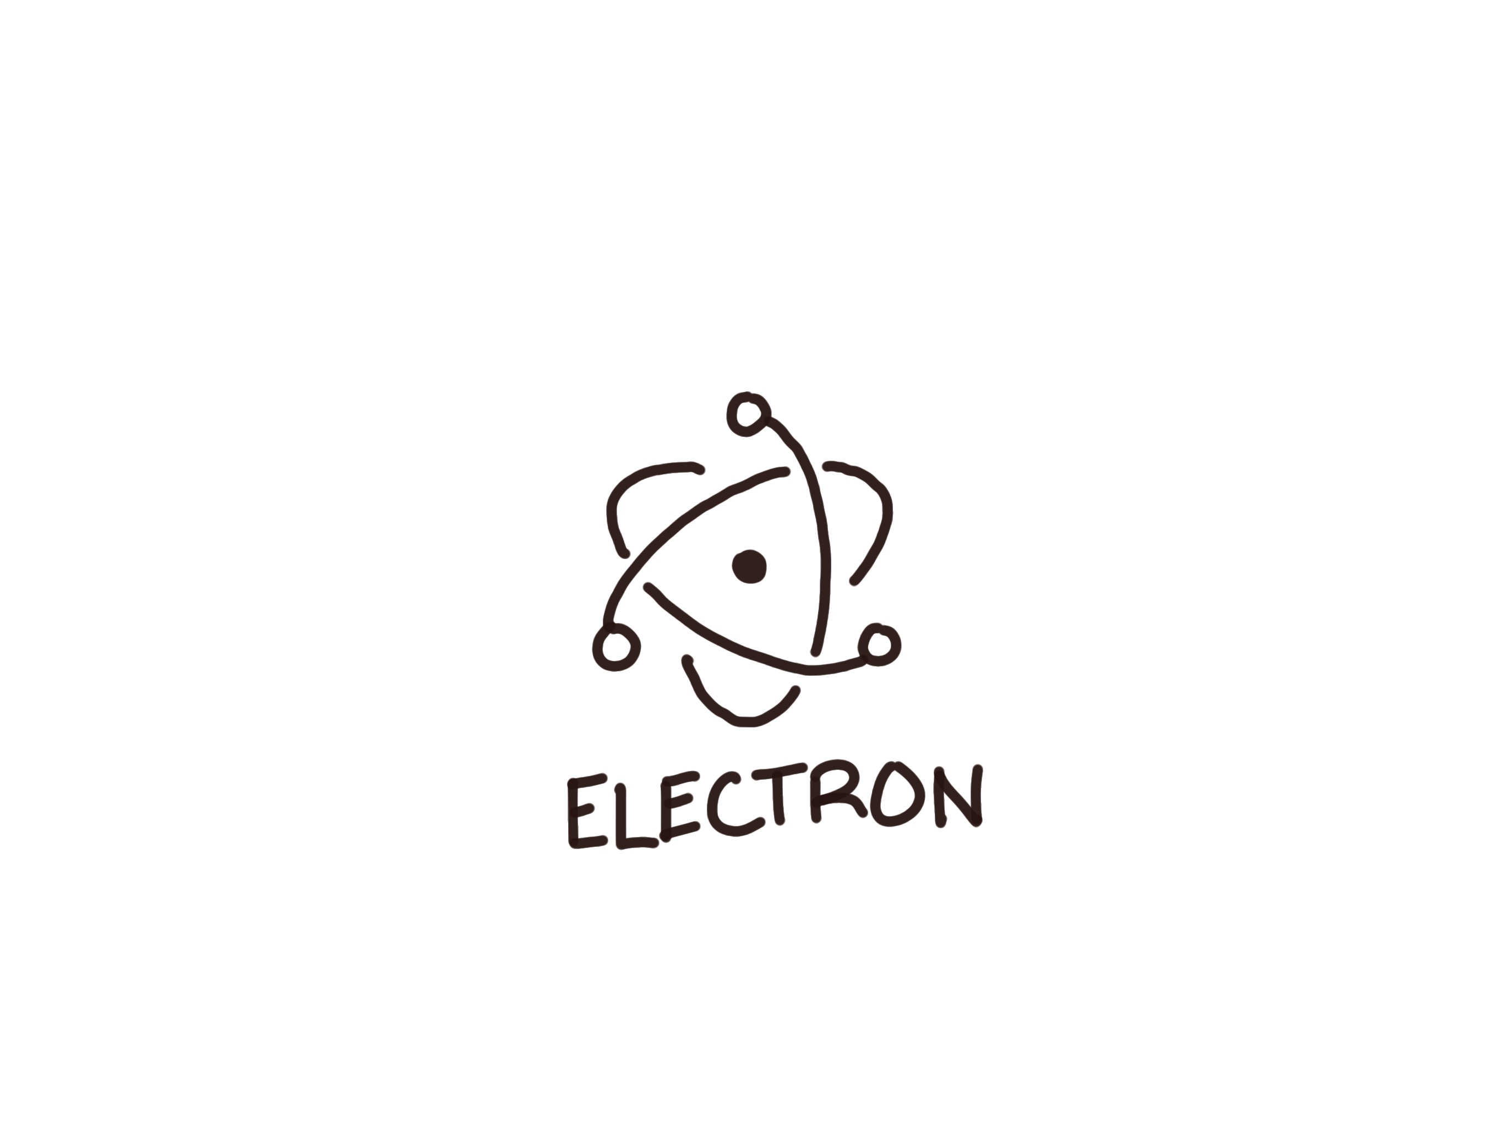


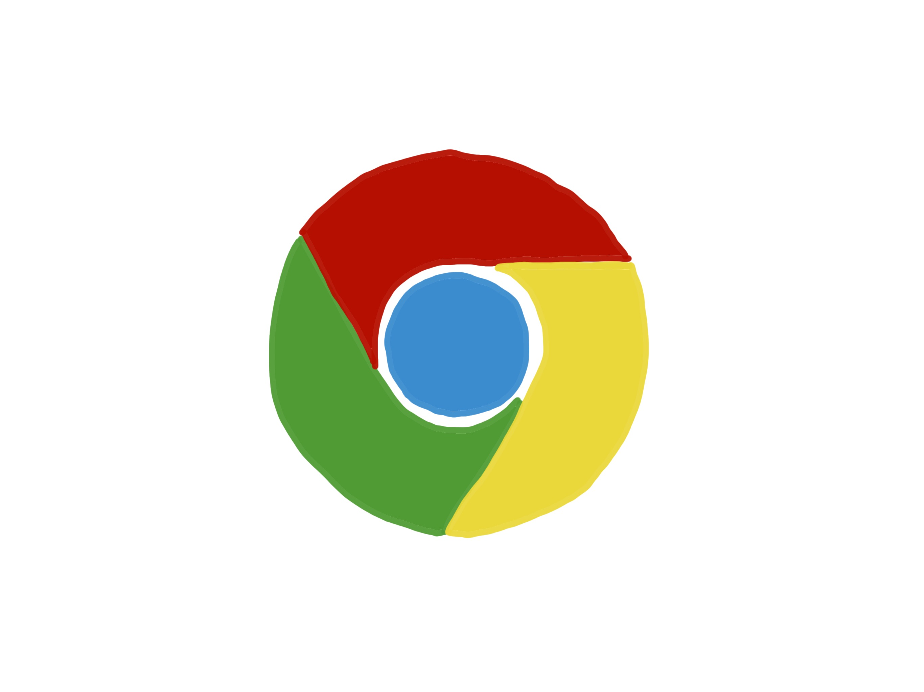
Electron
Pros:
HTML + CSS + JavaScript
Node.js + Chromium
No deployment dependencies

Slide 7


Slide 8
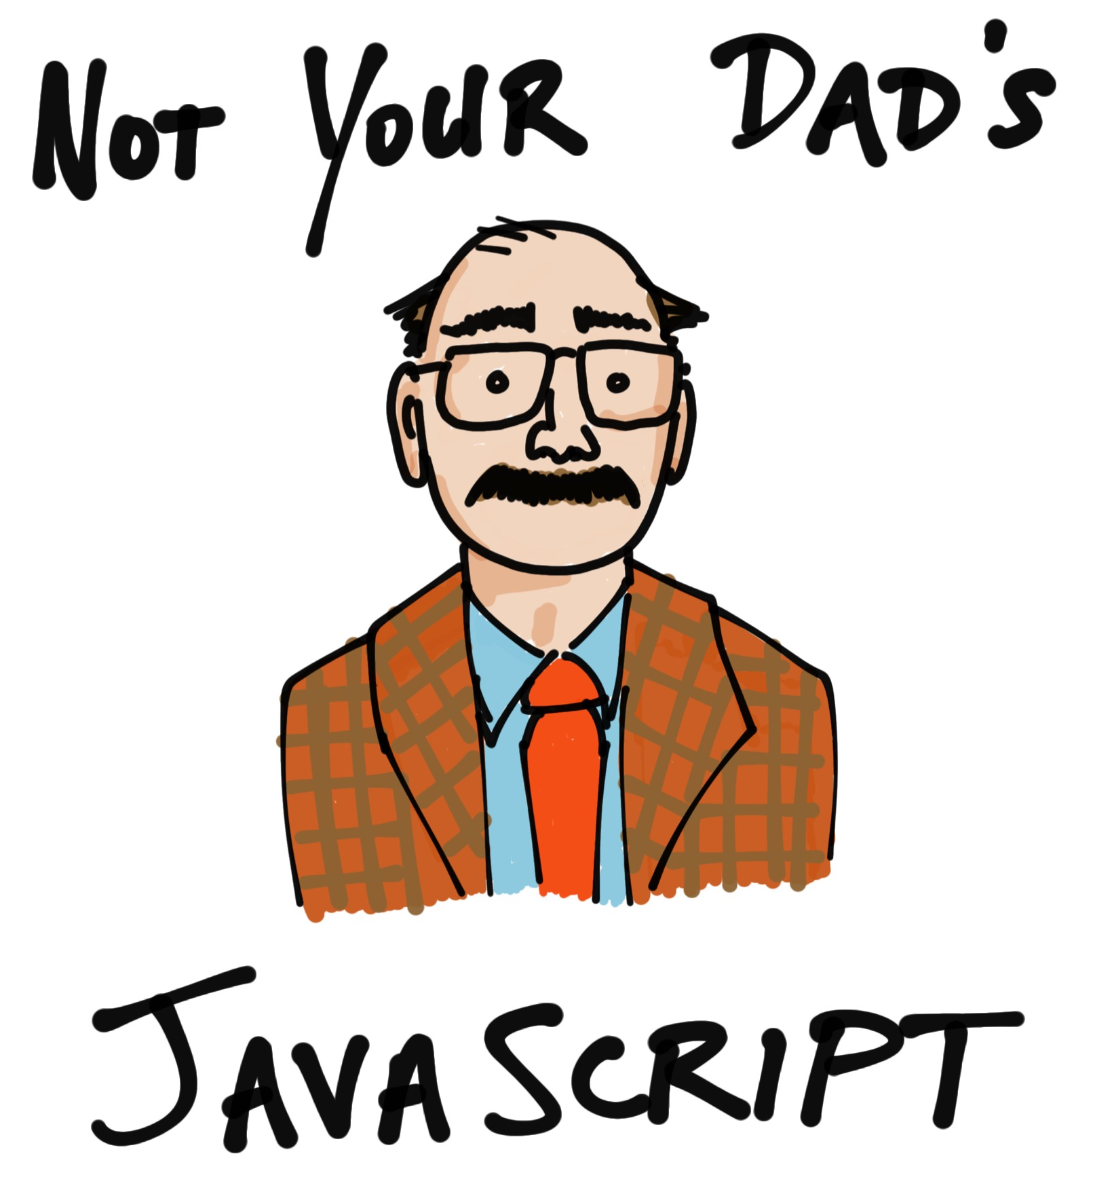

Slide 9

Electron
Cons:
HTML + CSS + JavaScript

Slide 10

History
Created by GitHub for Atom
Formerly Atom Shell
Active since January 2013
1.0 release May 2016
2.0 release May 2018

Slide 11

Electron Features
Rapid development
Themes
Shared code/UI
Deployment + “silent” updates
Native UX
Notes:
Native UX: extensions like native file open/save, print, notifications, and tray notifications

Slide 12
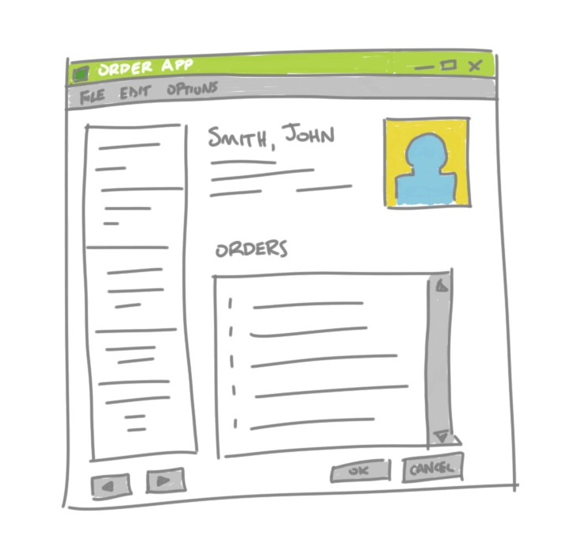
Why Desktop Apps?
Offline
Printers, devices, other local hardware
On-premises
Internal, LOB
Edit local files
App Store
Kiosk
Desktop > Intranet
Sometimes it “just feels right”

Slide 13

Desktop App Ideas
Disconnected data entry
Editor
Time management
Media player
Email client
Messaging, collaboration
Kiosk
Mapping, route planner
Social media client
Calendar
Bulk media editor
File management, backup
Document generation, reading
Audio/video conferencing
Games

Slide 14
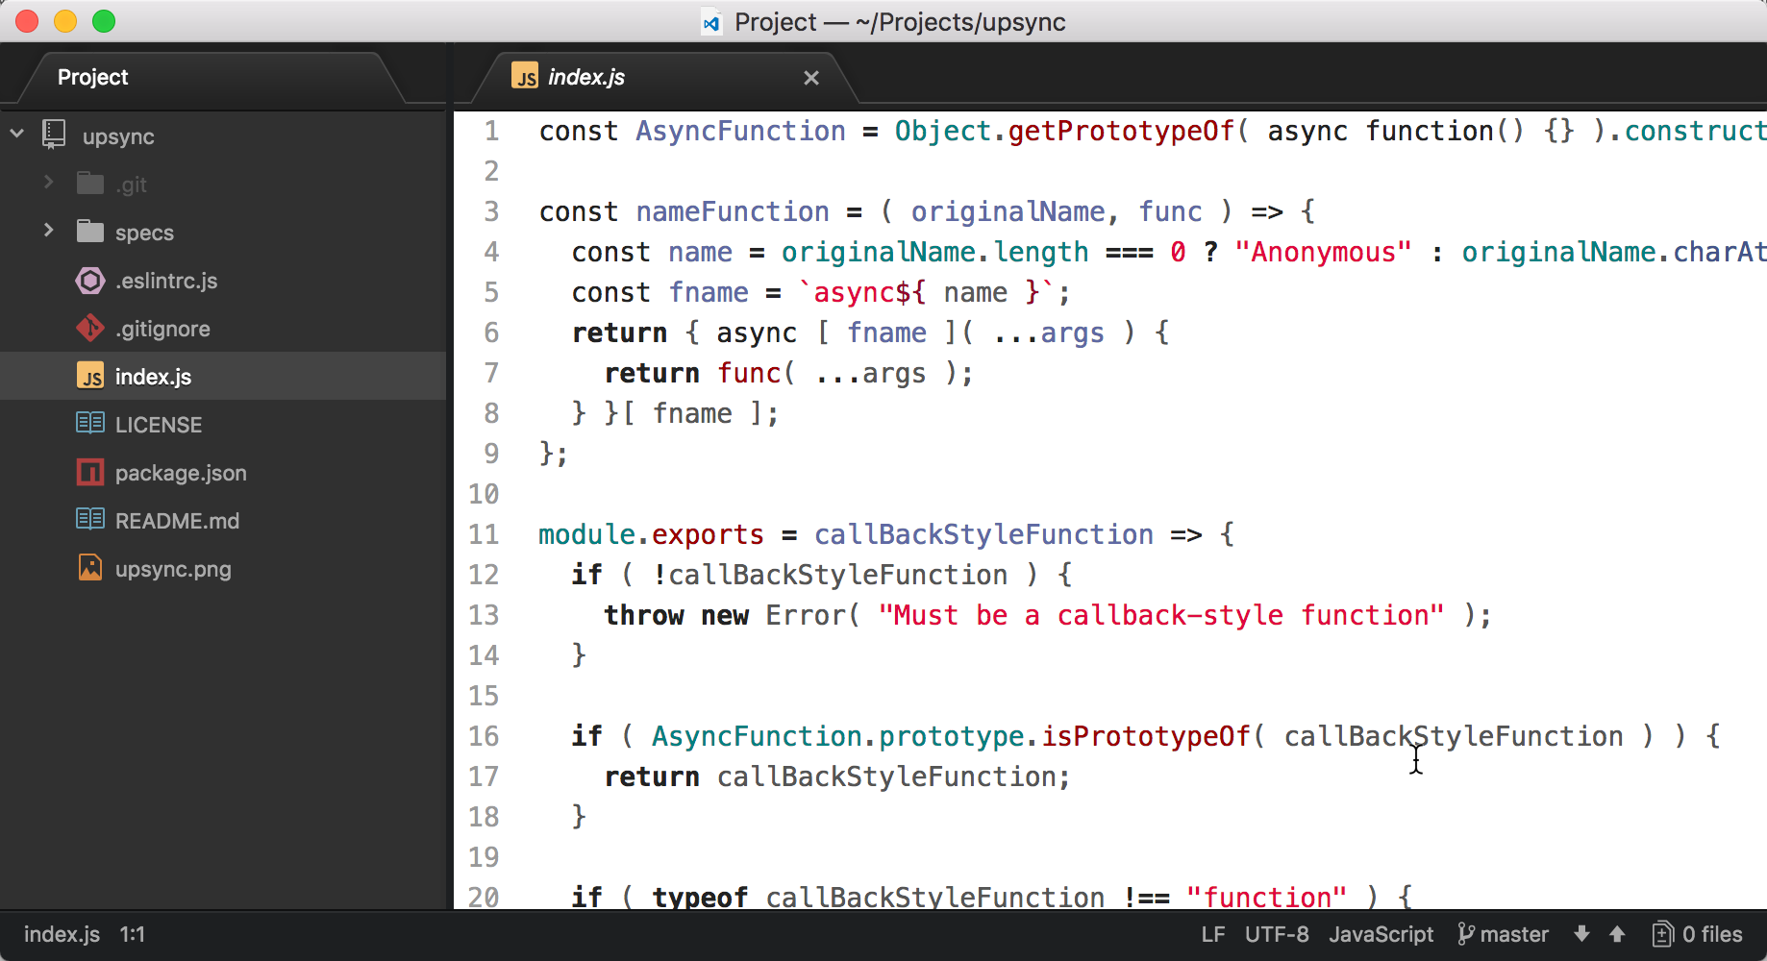
Atom

Slide 15
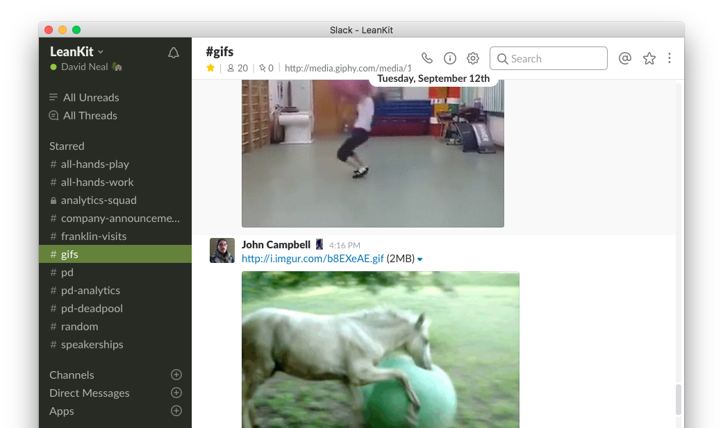
Slack

Slide 16
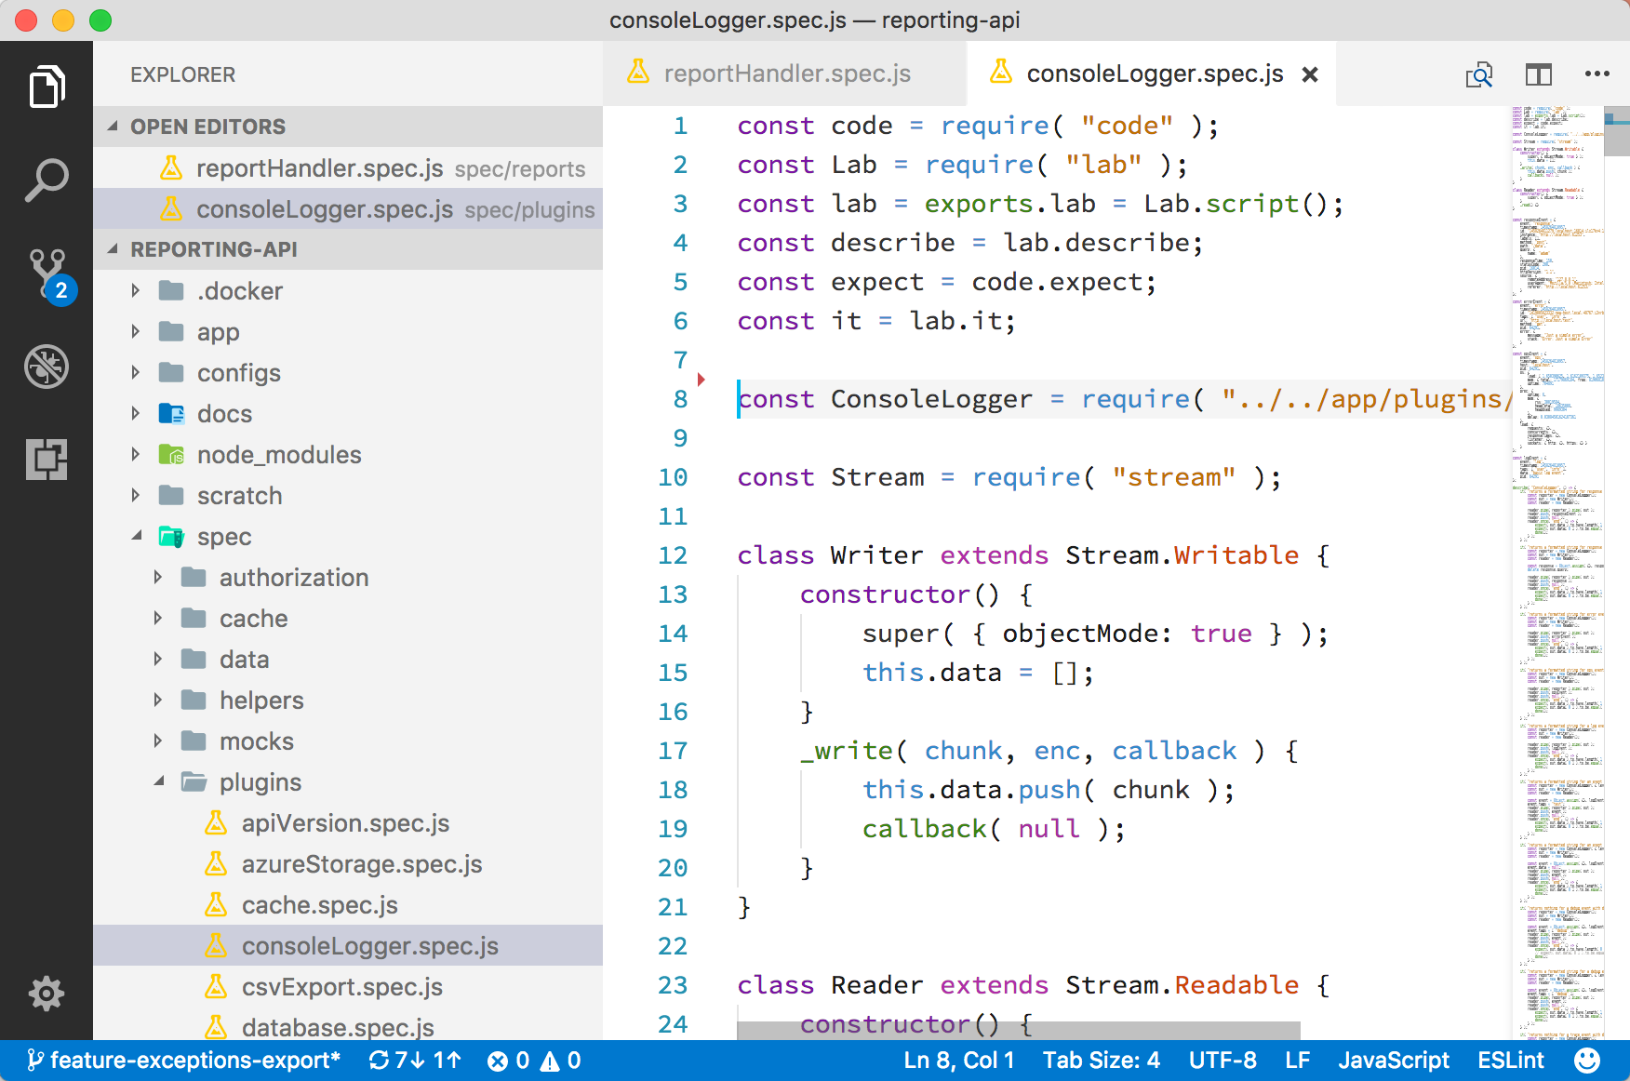
Visual Studio Code

Slide 17
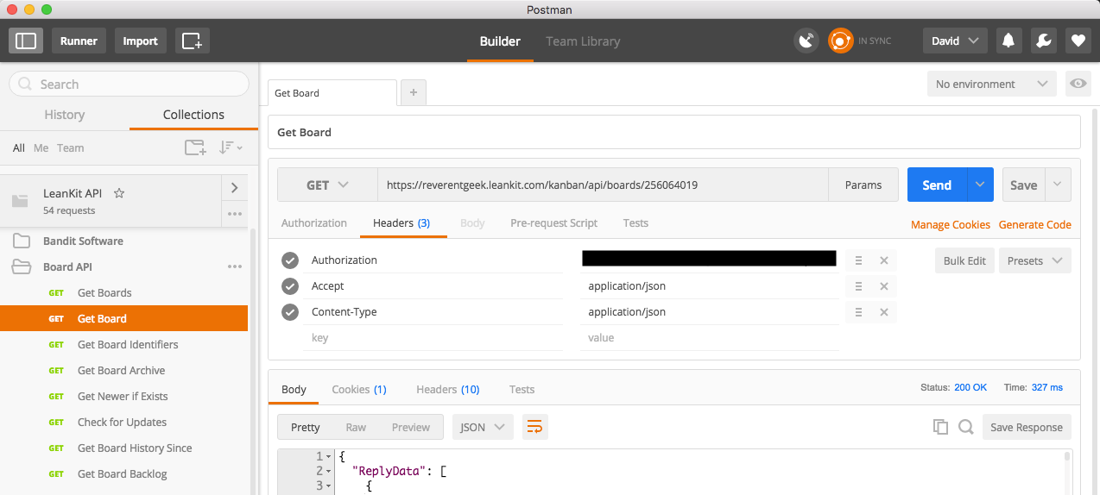
Postman

Slide 18
GitHub Desktop

Slide 19
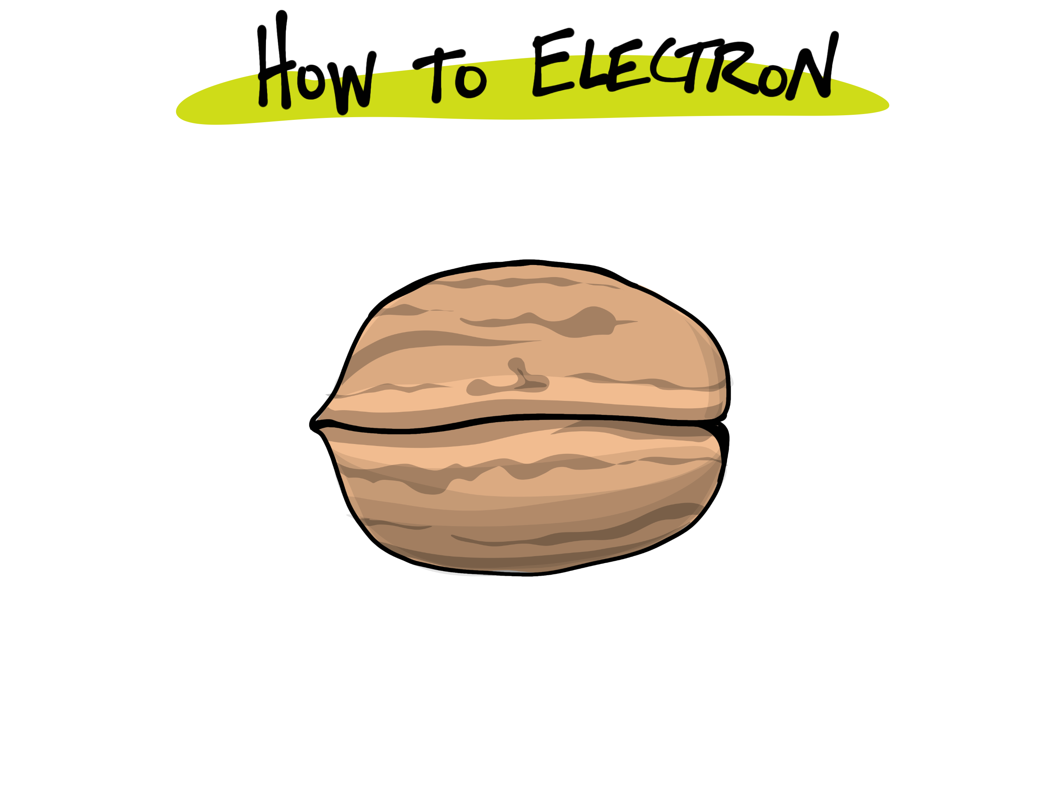

Slide 20
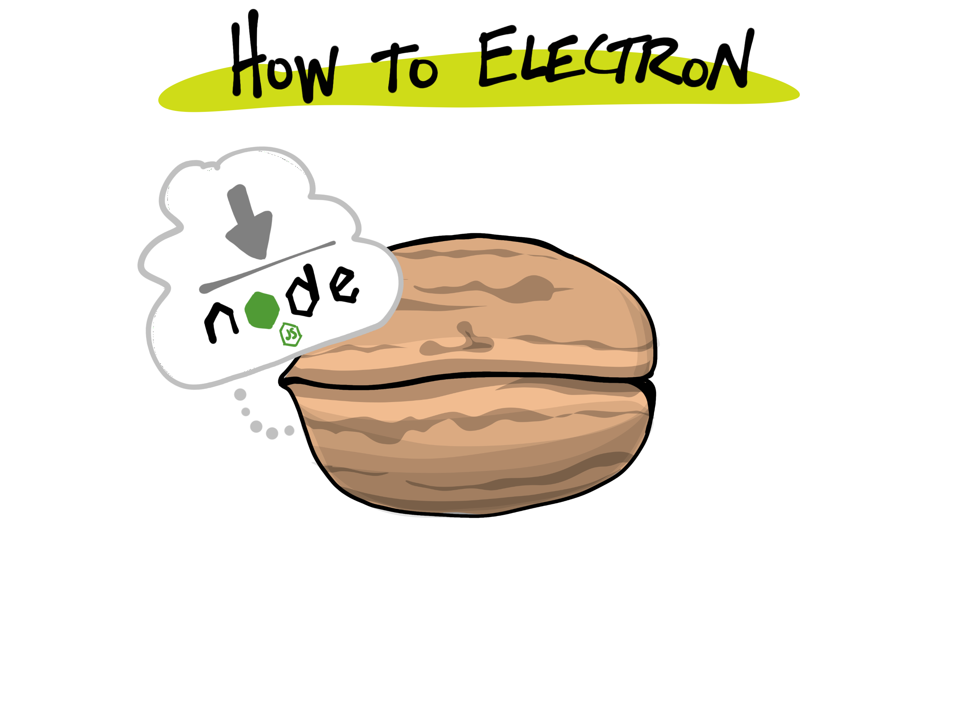

Slide 21
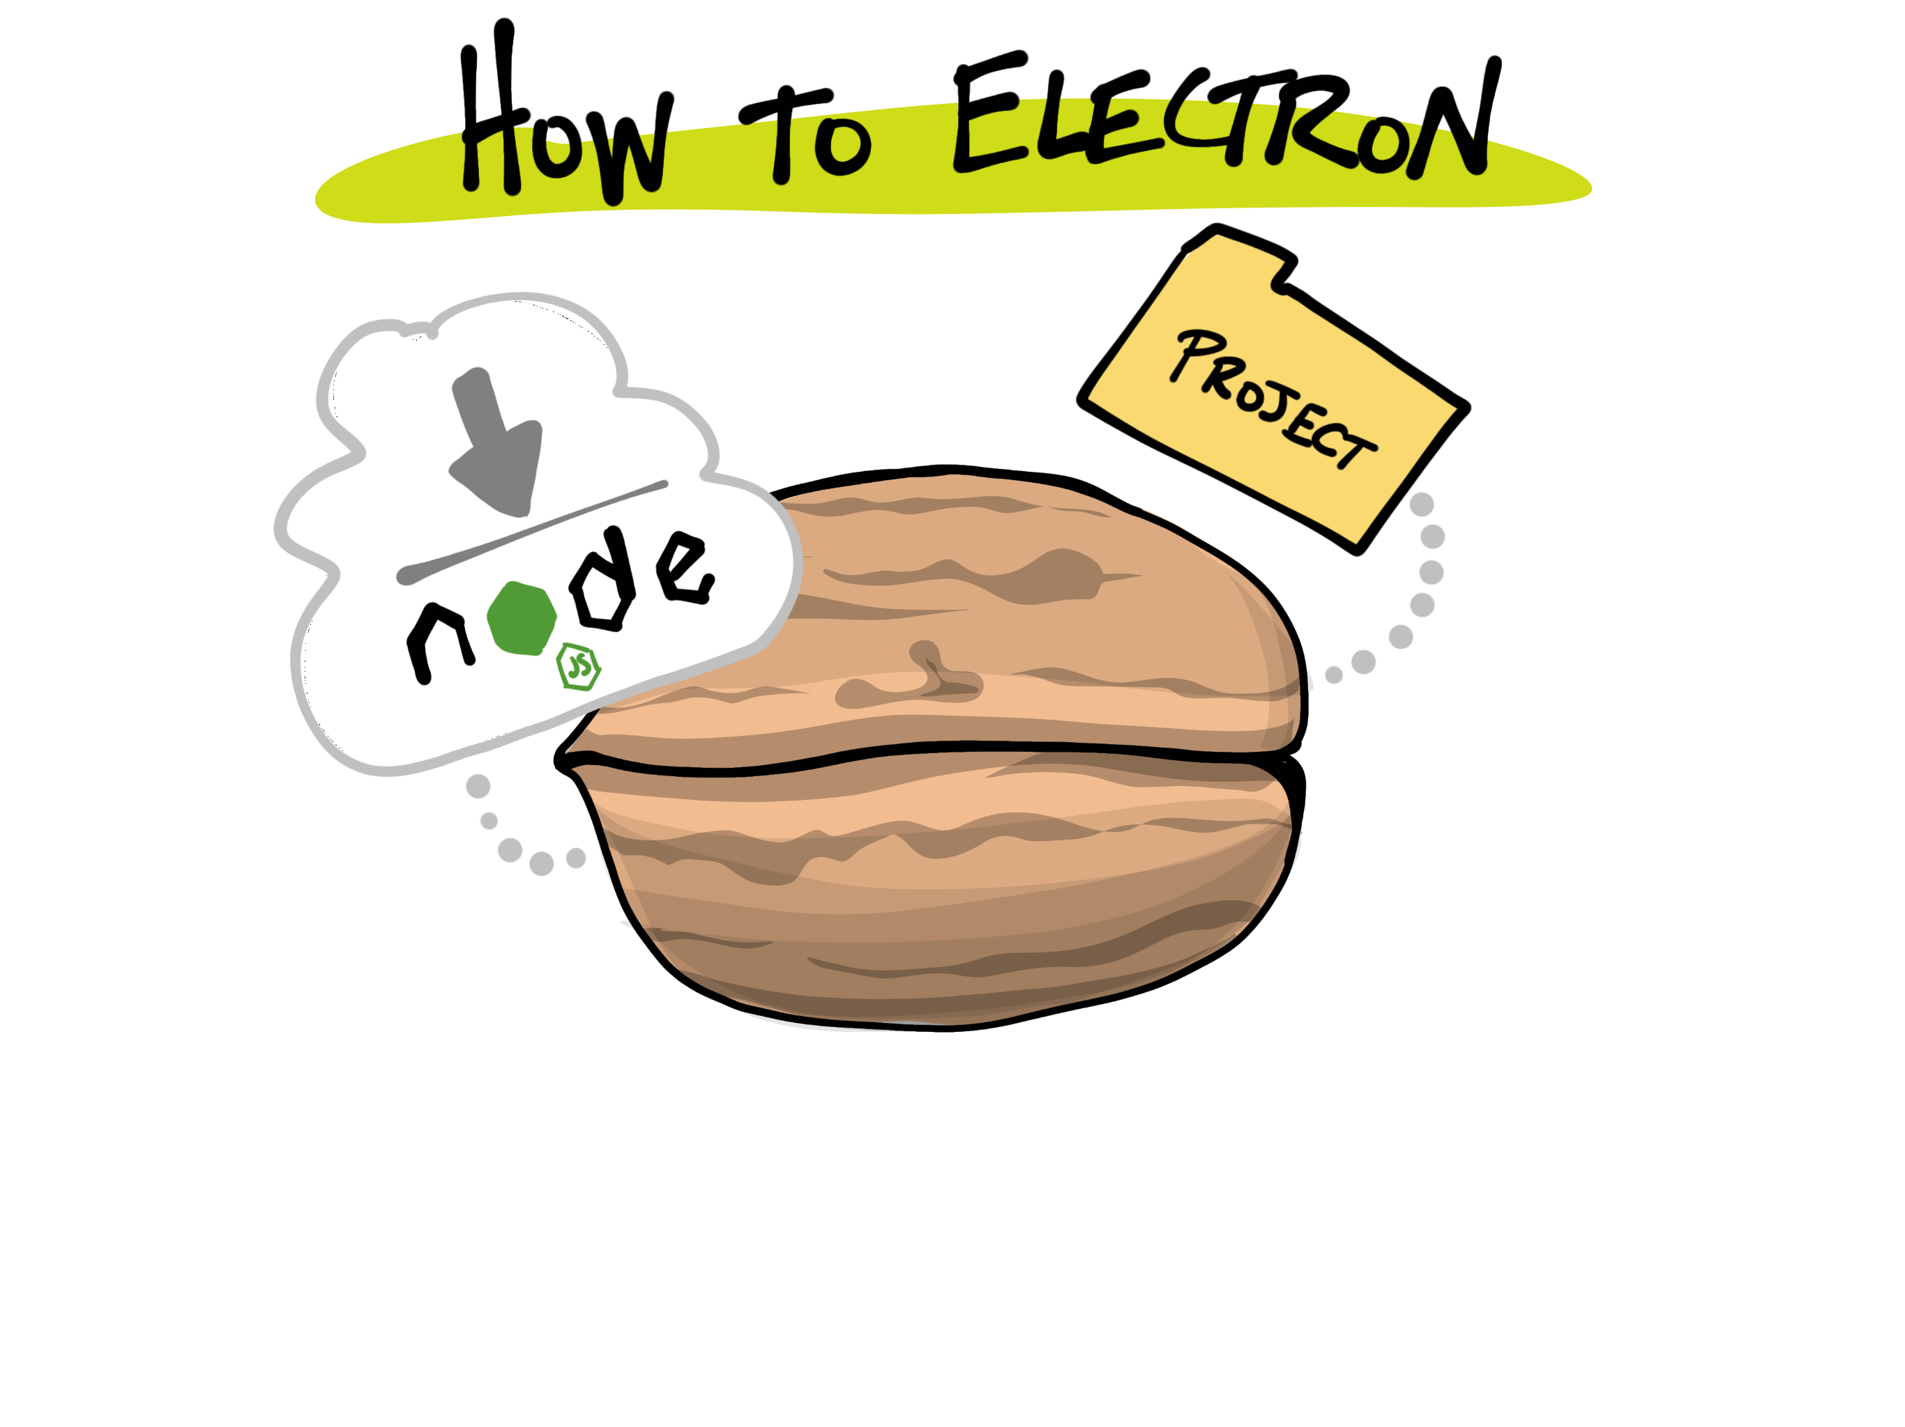

Slide 22
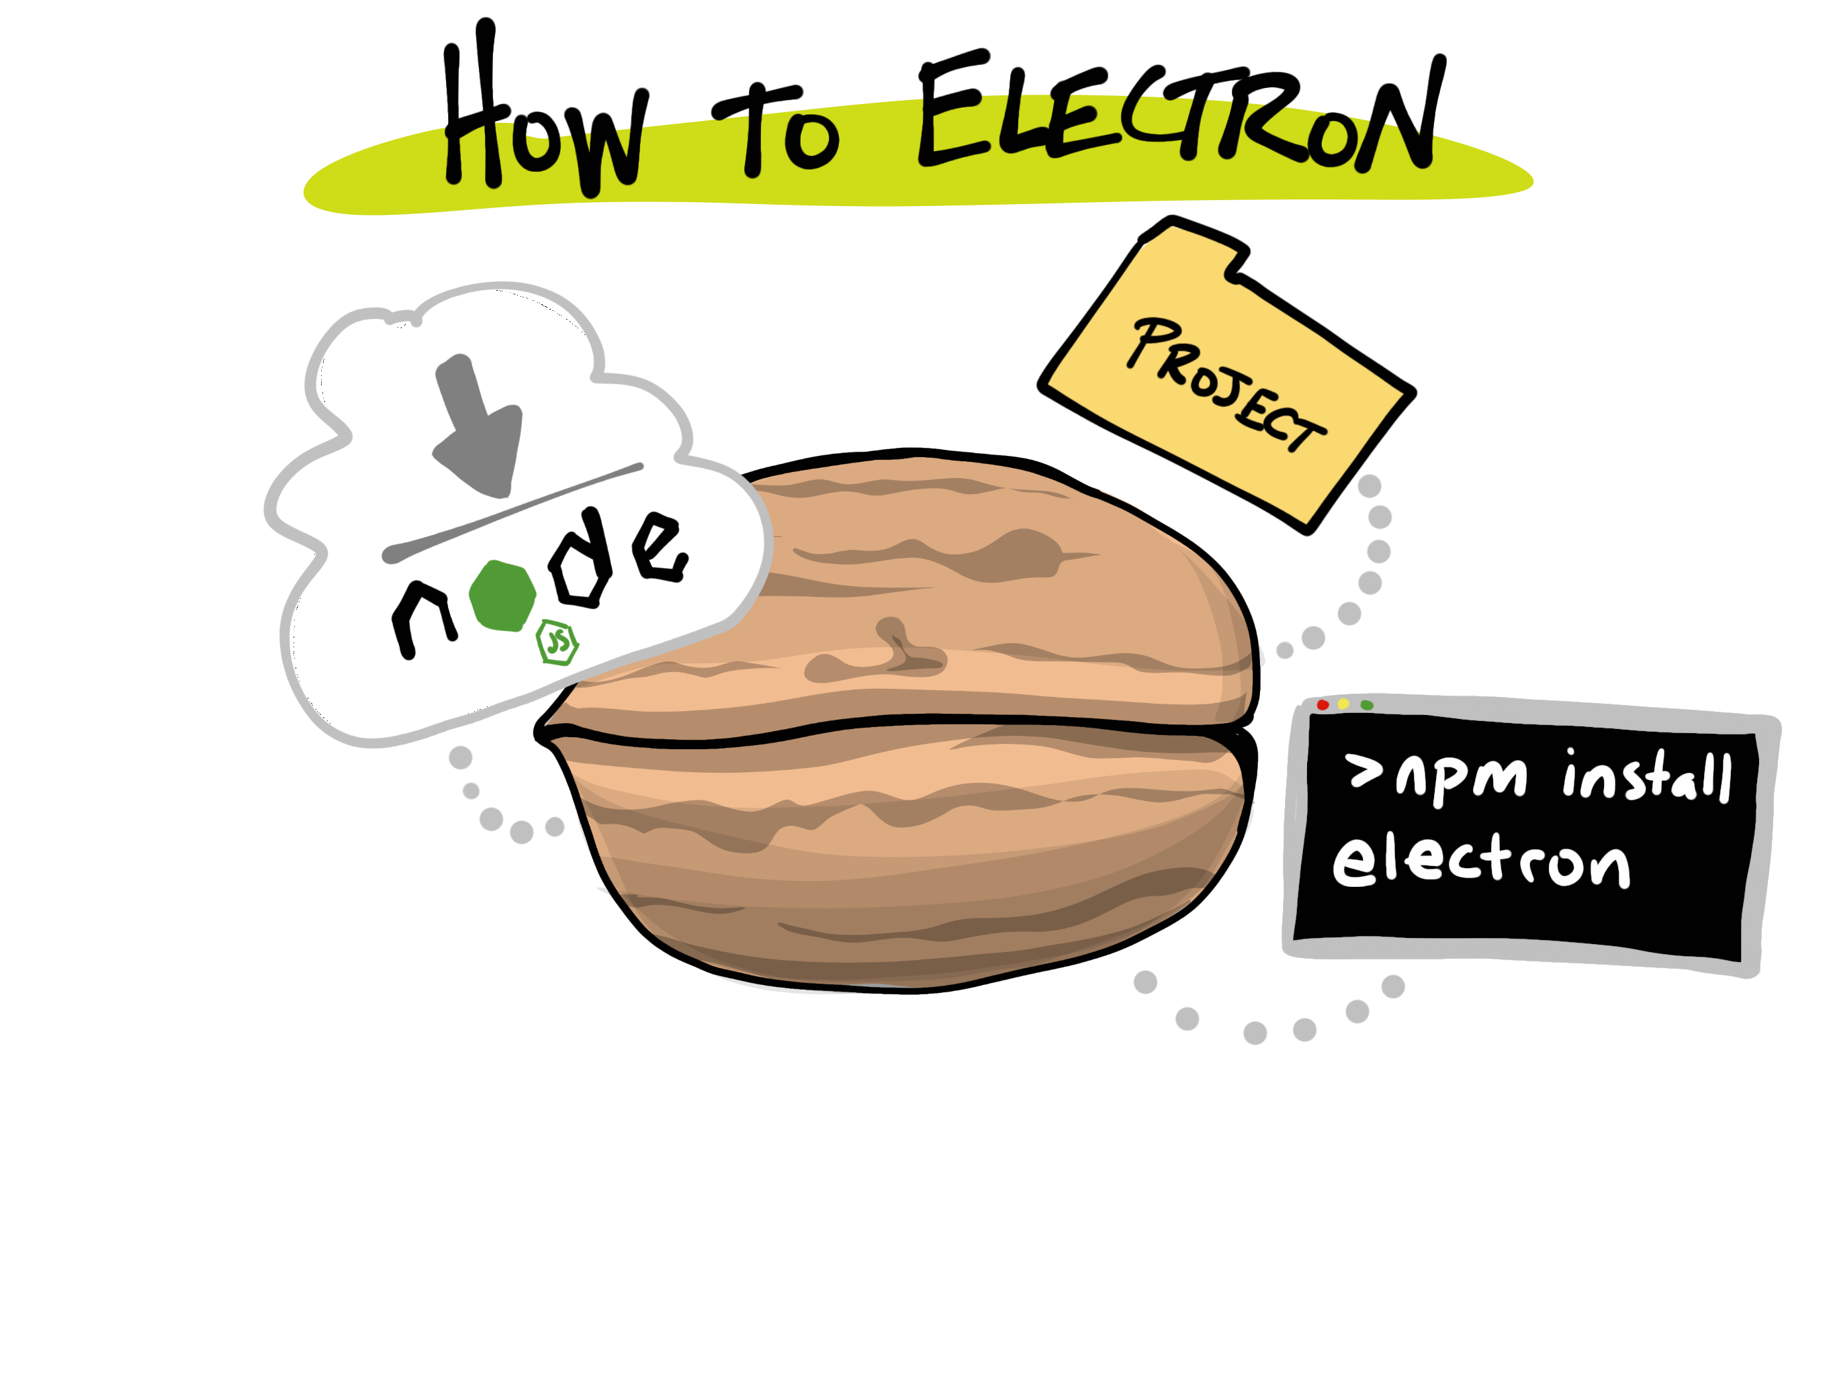

Slide 23
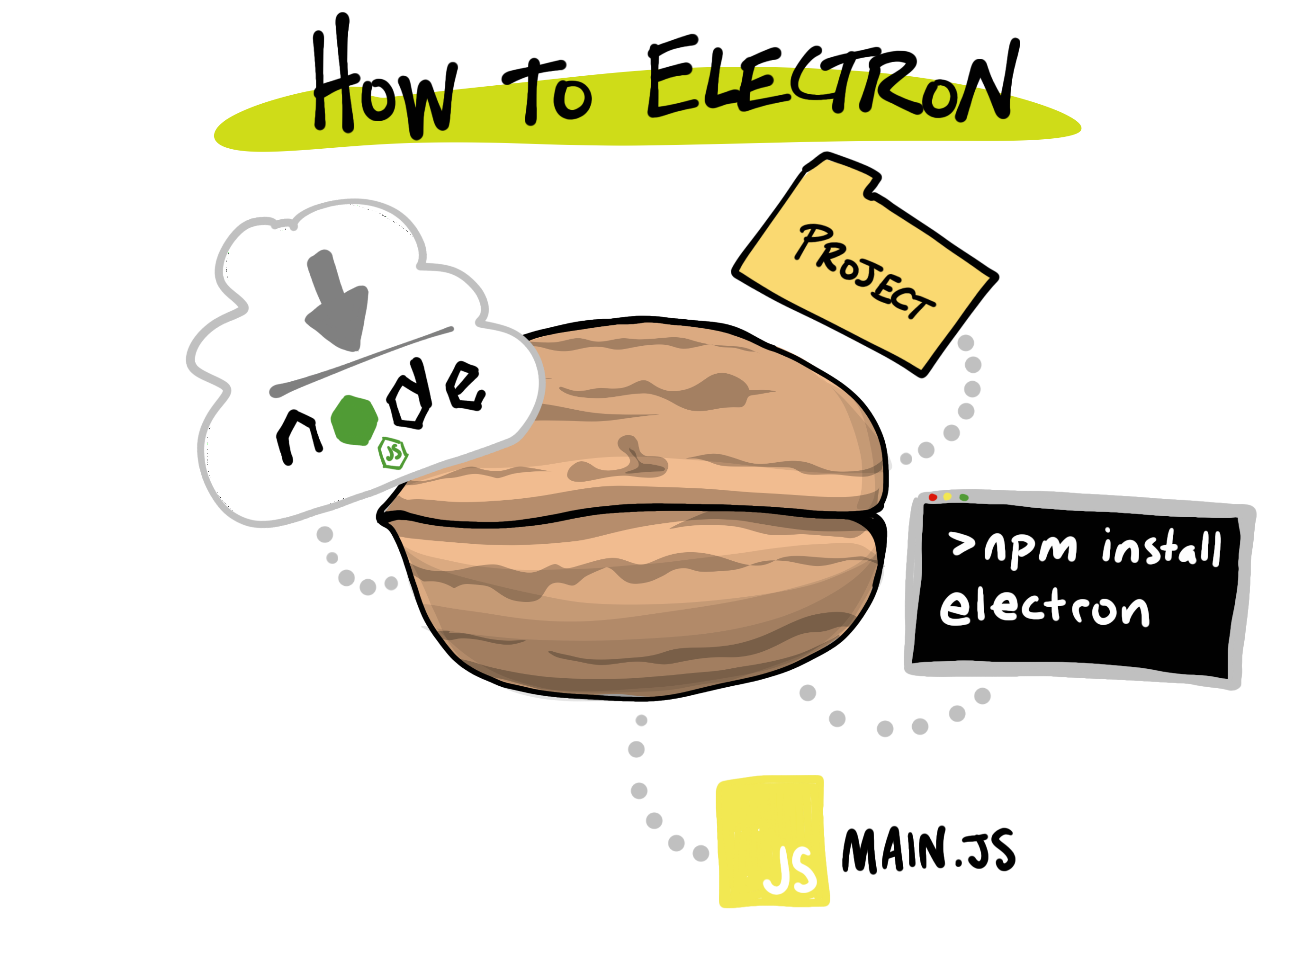

Slide 24


Slide 25
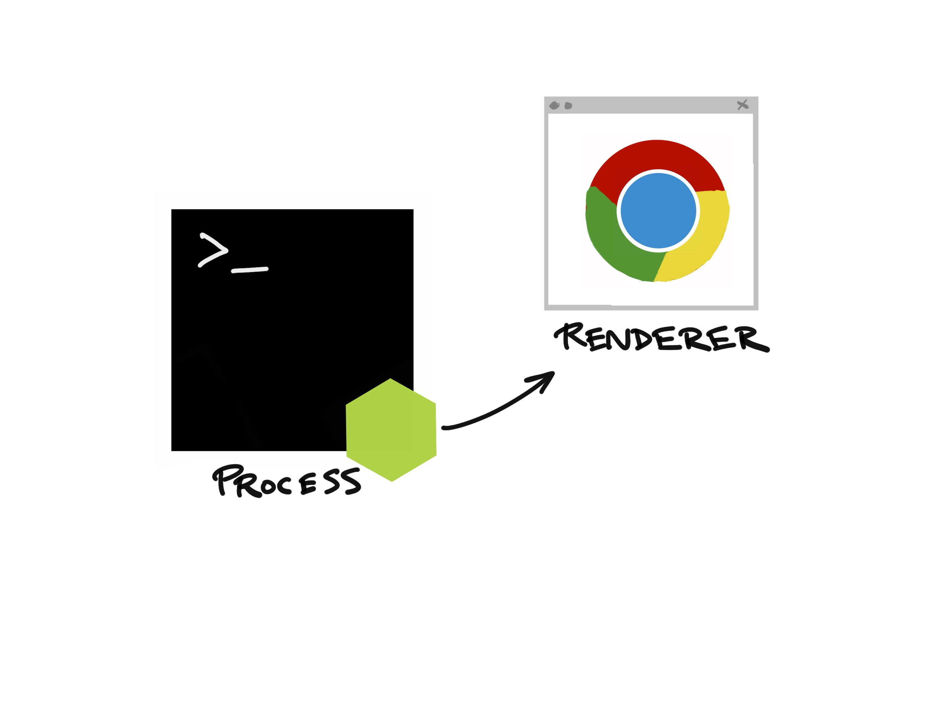
( main.js )
Notes:
Now I’d like to show you just how easy it is to get started with Electron…

Slide 26
( main.js )
Notes:
Now I’d like to show you just how easy it is to get started with Electron…

Slide 27
( index.html )
( main.js )
Notes:
Now I’d like to show you just how easy it is to get started with Electron…

Slide 28
( home.html )
( editor.html )
( settings.html )
( main.js )
Notes:
Now I’d like to show you just how easy it is to get started with Electron…

Slide 29

Notes:
Now I’d like to show you just how easy it is to get started with Electron…

Slide 30
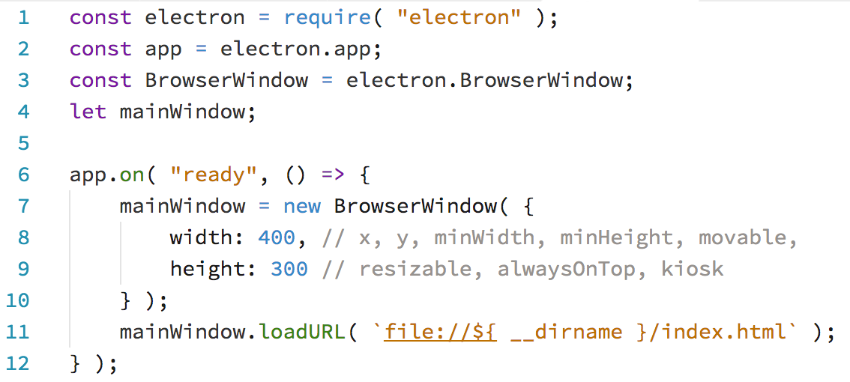
main.js

Slide 31
main.js

Slide 32
main.js

Slide 33
main.js

Slide 34
main.js

Slide 35
main.js

Slide 36
main.js

Slide 37
main.js

Slide 38
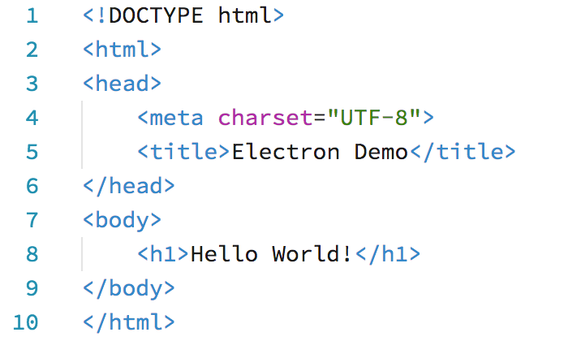
index.html

Slide 39
index.html
> npm start

Slide 40
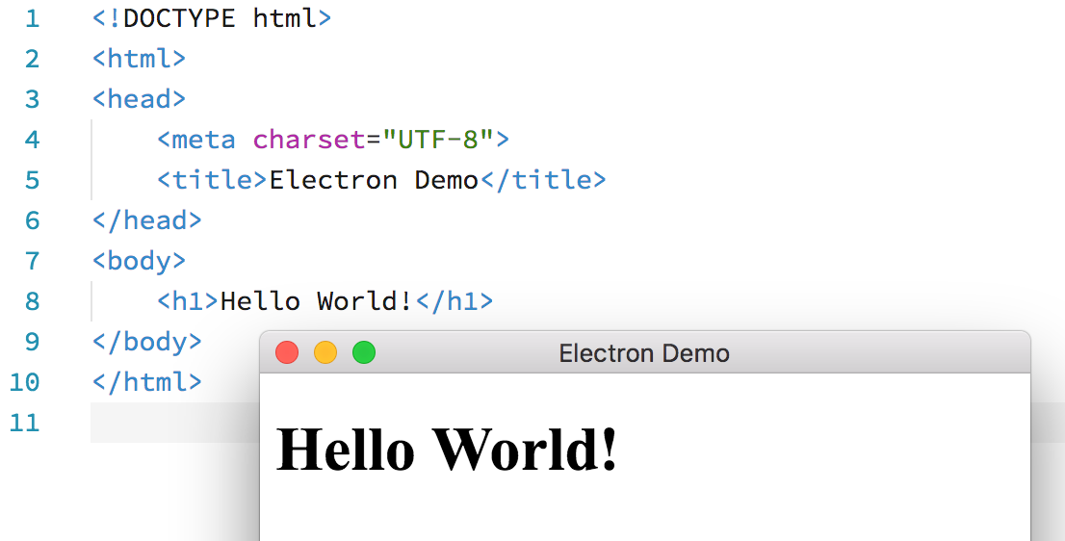
index.html
Notes:
Now I’d like to show you just how easy it is to get started with Electron…

Slide 41
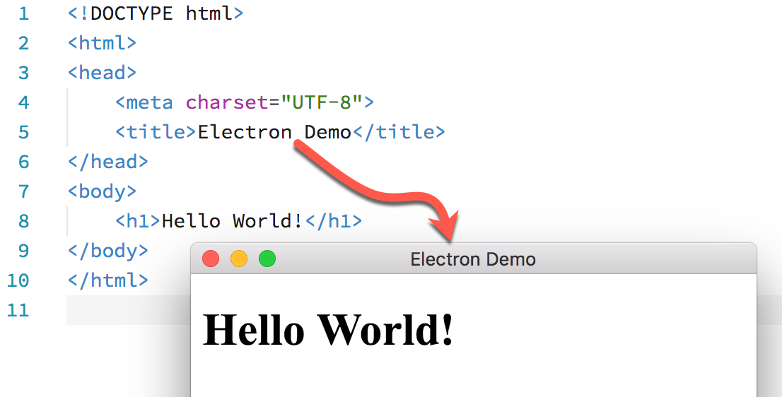
index.html
Notes:
Now I’d like to show you just how easy it is to get started with Electron…

Slide 42
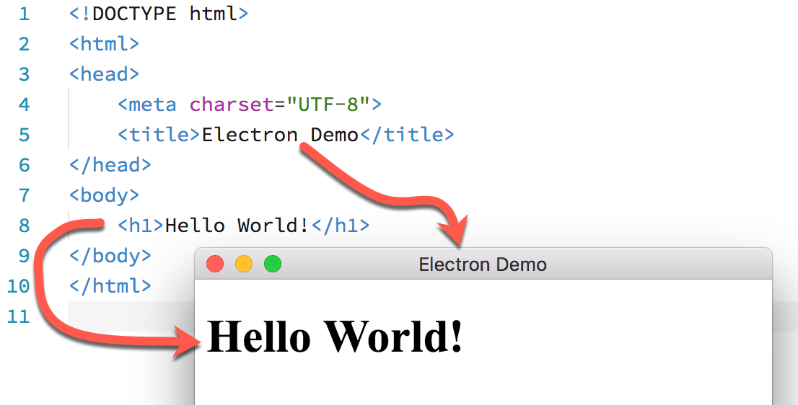
index.html
Notes:
Now I’d like to show you just how easy it is to get started with Electron…

Slide 43
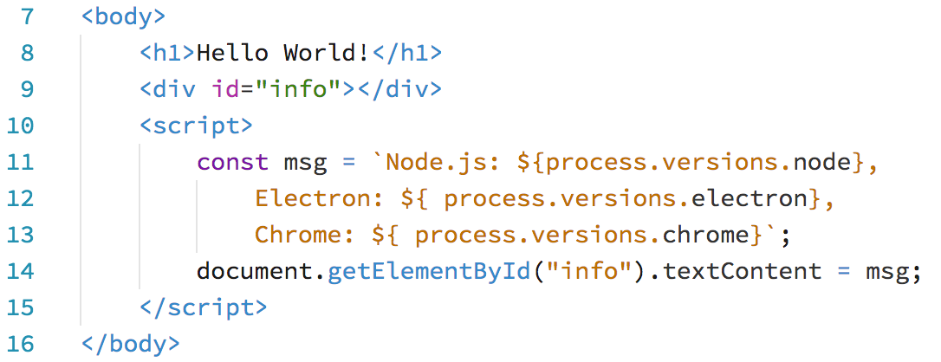
index.html

Slide 44
index.html

Slide 45
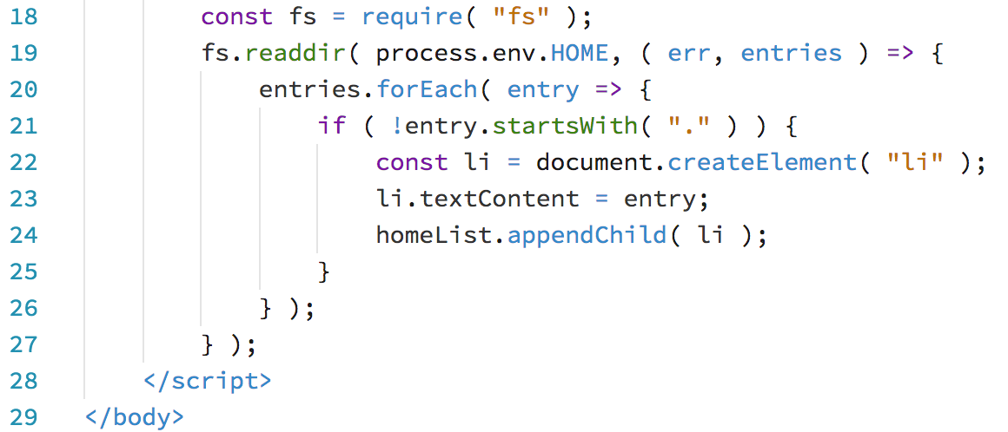
index.html

Slide 46
index.html

Slide 47
index.html

Slide 48
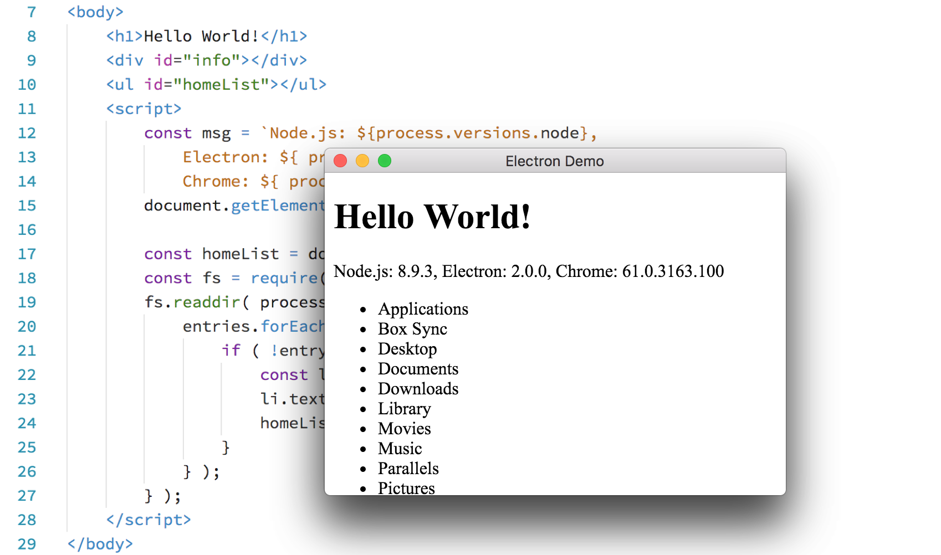
Notes:
Now I’d like to show you just how easy it is to get started with Electron…

Slide 49
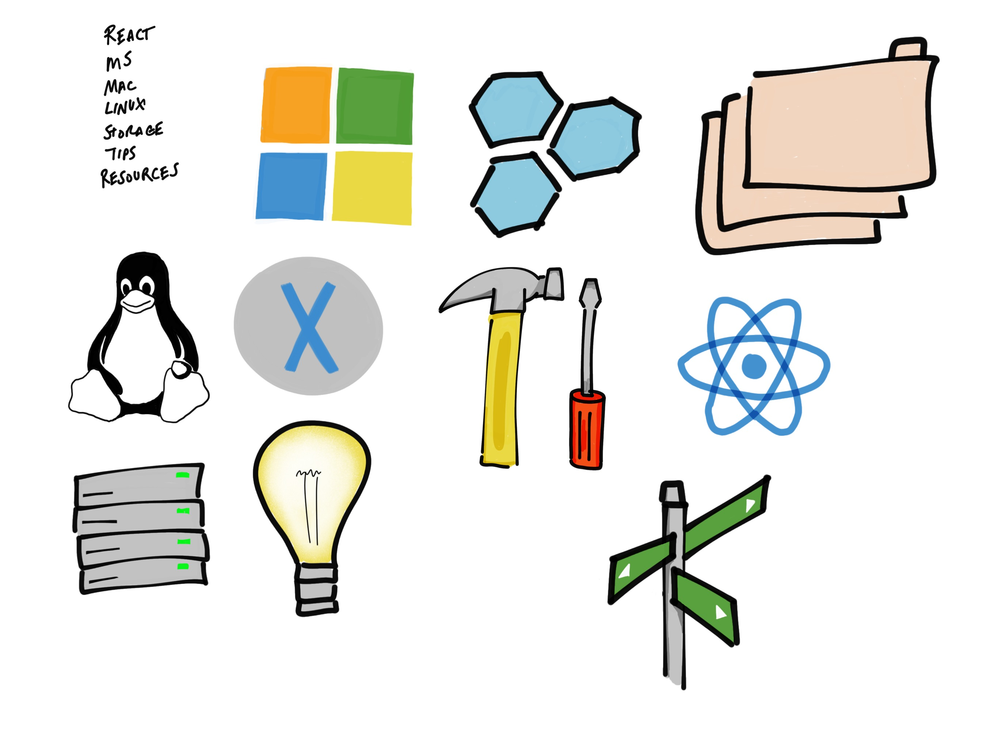
Process modules
app
ipc
dialog
menu, menu-item
power-monitor
tray
Notes:
App: application lifecycle events, command-line arguments, system/user paths, launch browser windows (renderers)
Dialog: File Open/Save, Info and Error
Menu: Native app and context menus
Power monitor: monitor power state changes

Slide 50
Render modules
ipc
remote
web-frame

Slide 51
Modules available to both
clipboard
crash-reporter
native-image
screen
shell
Notes:
Screen: enumerate displays, cursor location, display events
Shell: open item with default app, move files to trash, beep()

Slide 52
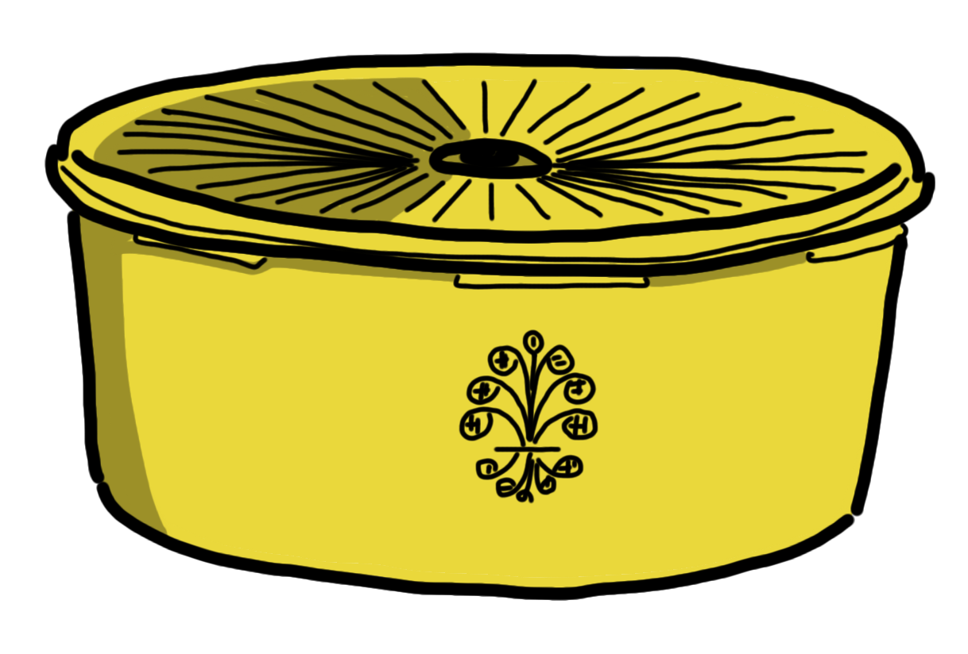
Local Storage
Read/write .json files
Pro tip: use fs-jetpack
nedb
pouchdb

Slide 53
Relational DB Storage
seriate (SQL Server)
pg
mysql
oracledb

Slide 54
Let’s Get Started!
https://bit.ly/electron-workshop
- or –
https://github.com/reverentgeek/electron-workshop/wiki

Slide 55


Slide 56


